Slide 1

BUSINESS ANALYSIS AND VALUATION
Group - 11
Google collab Link

Slide 2
Srinath Murali | 2022B3A70594H
Piyush Nahata | 2022B3A70654H
Mayan Vajani | 2022B3A70611H
Kanishk Agarwal | 2022B3A71390H
Yuvan Kanthamaneni | 2022B3A70785H
R Tarun Kumar | 2022B3A71606H

Slide 3
About the company
​Godrej Consumer Products Limited (GCPL) is a prominent Indian multinational company specializing in consumer goods. As part of the over 125-year-old Godrej Group, GCPL has established a strong presence in the global market.
Founded: GCPL was established in 2001 following the demerger of the consumer products division from Godrej Soaps Limited.
Headquarters: Mumbai, Maharashtra, India
Global Presence: GCPL's products are available in over 85 countries, catering to approximately 1.4 billion consumers worldwide.
Employees: The company employs over 8,670 individuals across its operations. ​

Slide 4
About the company
Mission: GCPL is committed to fostering a culture of creativity and collaboration among its employees and aims to expand its reach in international markets while maintaining a robust local presence.
Values: The company operates sustainably and responsibly, focusing on the well-being of communities and the environment.
Product Portfolio: GCPL offers a diverse range of products, including soaps, hair colorants, toiletries, liquid detergents, household insecticides, and air care products. Notable brands under GCPL include 'Cinthol', 'Godrej No.1', 'Godrej Expert', and 'Ezee'.
Leadership: Nisaba Godrej has been serving as the Executive Chairperson of GCPL since May 2017. ​
Sustainability Initiatives: GCPL places a strong emphasis on sustainability and social responsibility, actively championing social initiatives for over 125 years. ​
Financial Highlights: For the fiscal year 2023-24, GCPL reported revenues of USD 1.7 billion and a market capitalization of USD 15 billion.

Slide 5
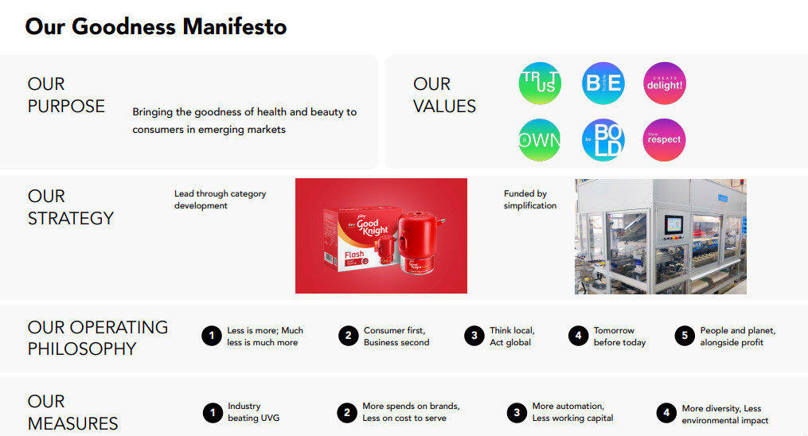

Slide 6

BOARD OF DIRECTORS

Slide 7
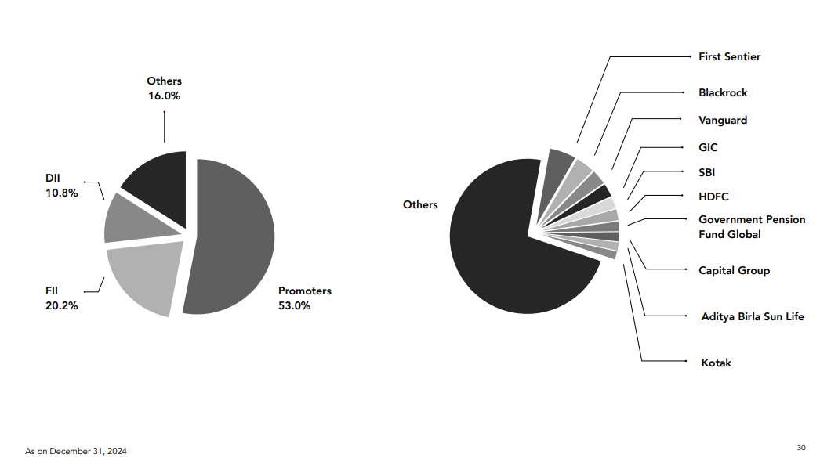
SHAREHOLDING PATTERN

Slide 8
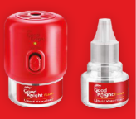

Product Portfolio
1. Home Care:
Household Insecticides:
Goodknight: A leading brand providing mosquito repellents in various formats, including coils, liquids, and agarbattis.
HIT: Offers solutions for eliminating insects such as mosquitoes and cockroaches.​
Air Care:
Godrej aer: A range of air fresheners available in formats suitable for both homes and cars.​
Fabric Care:
Ezee Liquid Detergent: Specially formulated for delicate fabrics like woolens, ensuring gentle cleaning.​
Home Hygiene:
Godrej Protekt: Offers a variety of hygiene products, including hand sanitizers and disinfectant sprays.​

Slide 9
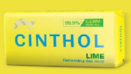
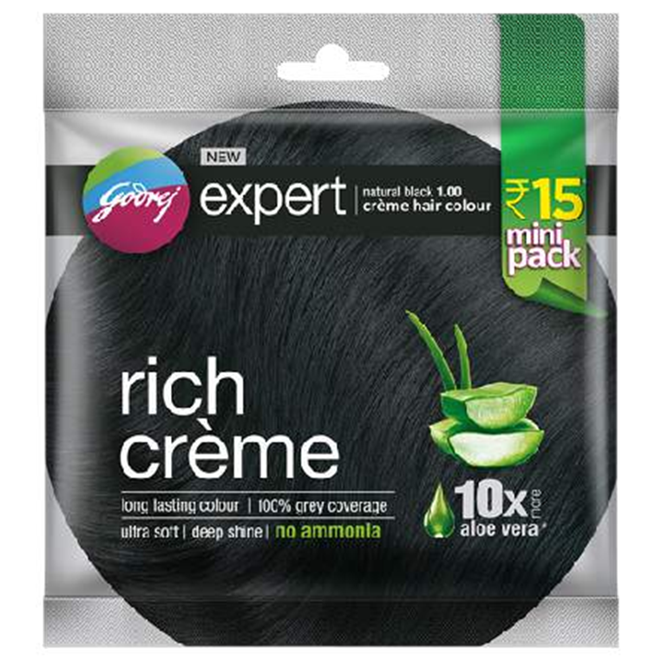
2. Personal Care:
Personal Wash and Hygiene:
Cinthol: A popular soap brand known for its refreshing fragrances and skin-friendly properties.​
Godrej No.1: Offers a variety of soaps enriched with natural ingredients.​
Hair Colour:
Godrej Expert Rich Crème: A no-ammonia hair color enriched with aloe vera and milk protein for nourishment.​
Renew: Provides long-lasting hair color solutions with a range of shades.​
Premium Beauty and Professional Products:
Bblunt: A professional hair care and styling brand offering salon-quality products.​
Godrej Professional: A dedicated range of professional hair products catering to salon needs.​

Slide 10
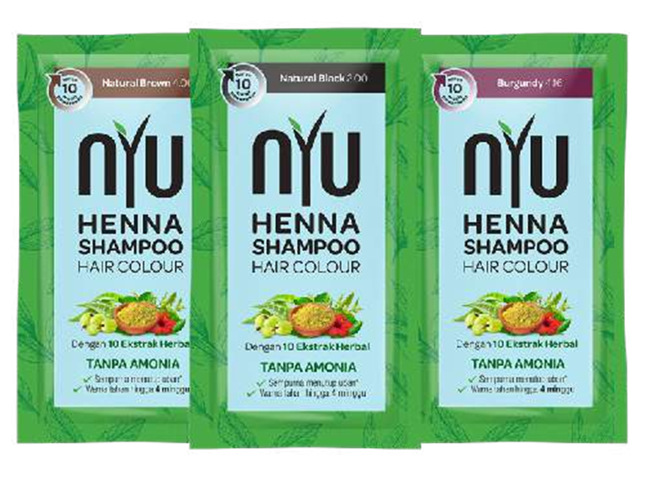

3. Hair Care:
Hair Extensions and Wigs:
Darling: Offers a variety of hair extensions and wigs, particularly popular in African markets.​
Inecto: Provides hair color and care products tailored for African hair types.

Slide 11
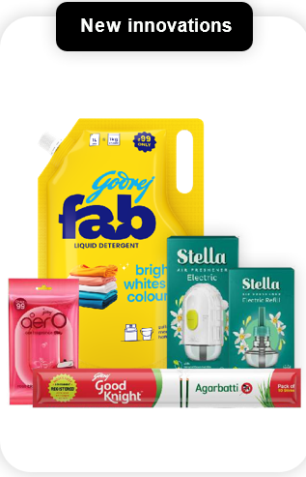
4. Recent Digital-First Innovations:
Godrej Ezee Detergent Pods: Single-use laundry capsules designed for convenience and effective cleaning.​
Godrej Protekt All-in-1 Dishwasher Tablets: Combines the benefits of detergent, rinse aid, and dishwasher salt in a single tablet.
Goodknight Anti Mosquito Bed Nets: High-quality bed nets designed to provide protection against mosquitoes.​
These products are available exclusively through e-commerce platforms, reflecting GCPL's commitment to digital transformation and meeting the needs of modern consumers in response to evolving consumer preferences and the rise of e-commerce.

Slide 12
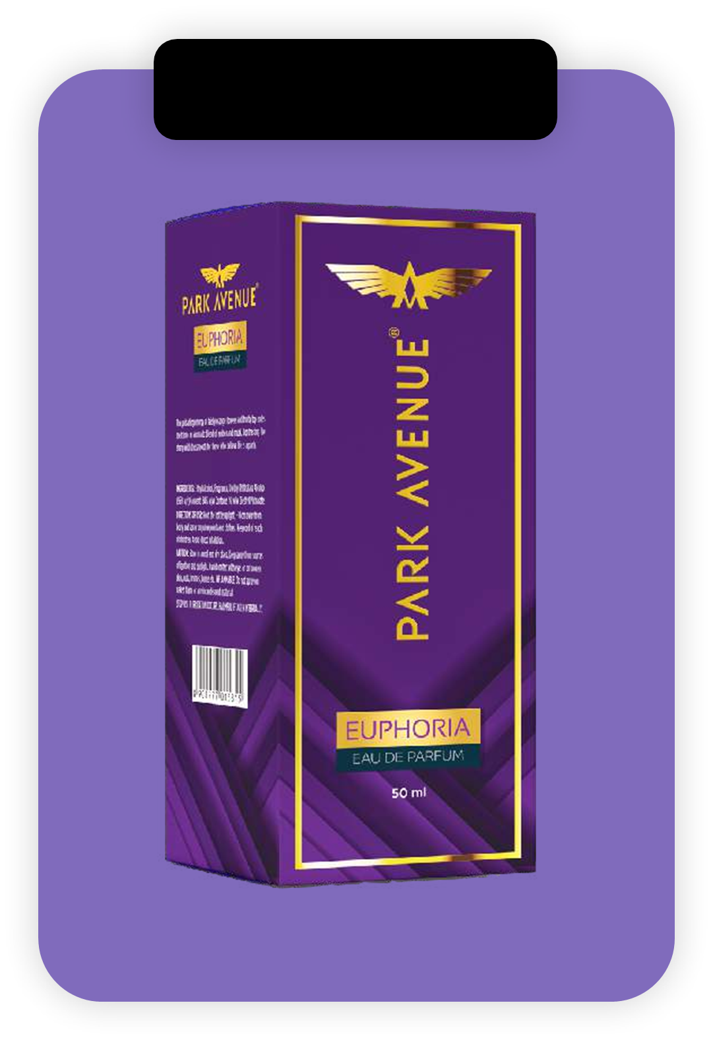
5. Acquisitions Enhancing Product Portfolio:
GCPL has strategically acquired brands to strengthen its market position:​
Park Avenue (Deodorants): Acquired from Raymond Consumer Care, expanding GCPL's presence in the deodorant segment.​
These acquisitions align with GCPL's strategy to focus on underpenetrated categories with significant growth potential. ​
GCPL's diverse product range, combined with its focus on innovation and strategic acquisitions, positions it as a leading player in the global consumer goods market.
Fine Fragrances

Slide 13
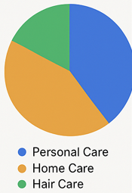
Revenue Generation Sources
🔹 1. Product-Based Revenue
Personal Care
Major contributor to revenue
Includes soaps (Godrej No.1, Cinthol), hair colors (Godrej Expert), and grooming products
Home Care
Includes insecticides (Goodknight, HIT), air fresheners (Godrej aer), fabric care (Ezee)
Strong presence in India and Southeast Asia
Hair Care
Products like extensions and styling (Darling, Bblunt, Inecto)
Focused on African markets

Slide 14
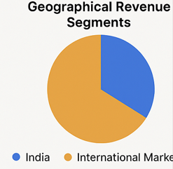
Revenue Generation Sources
🔹 2. Geographical Revenue Segments
India
Largest market
Accounts for ~59% of total revenue (₹83.17 billion in FY24)
International Markets (around 41% of revenue)
Indonesia – Strong in home care
Africa – Hair care (Darling, Inecto)
Latin America & USA – Smaller but growing markets

Slide 15
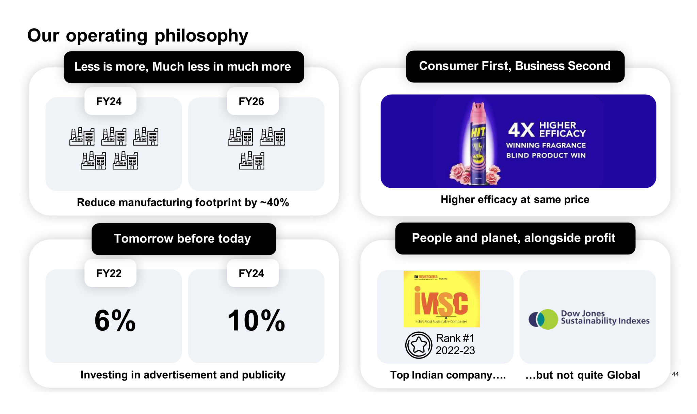

Slide 16
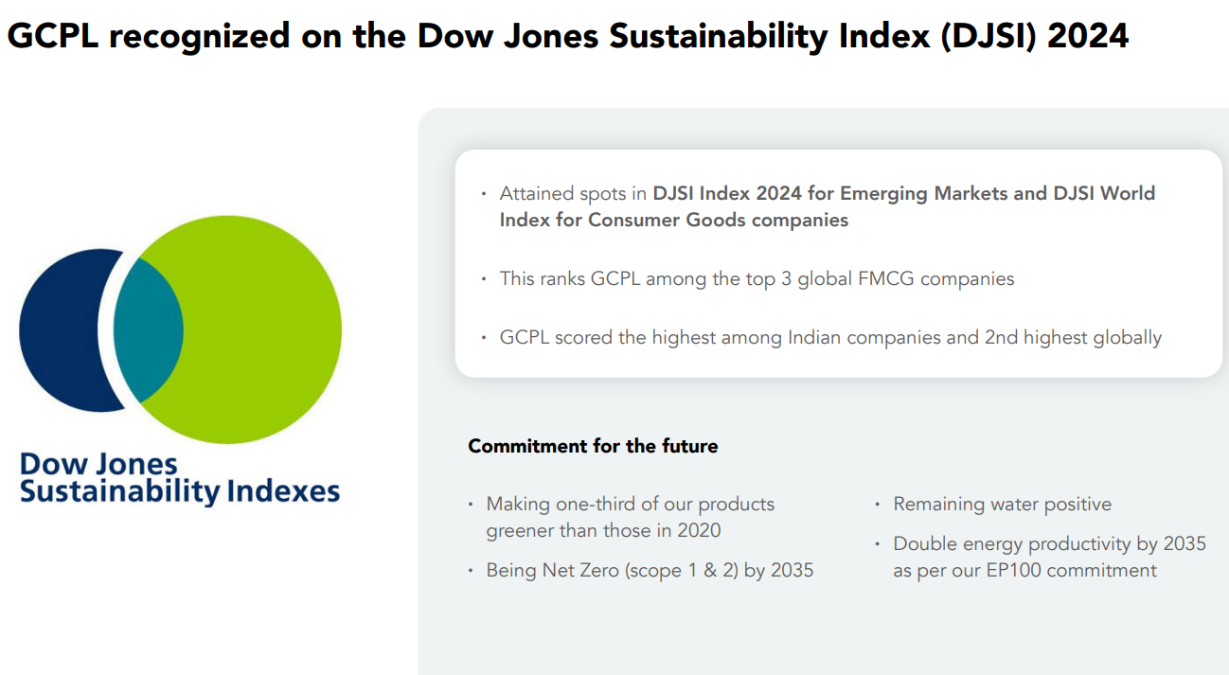

Slide 17

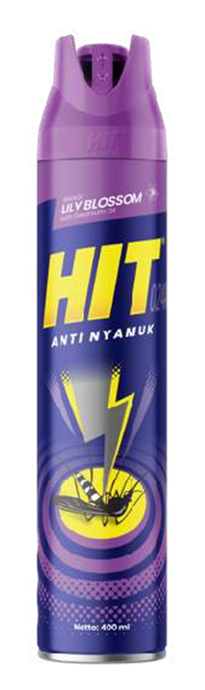
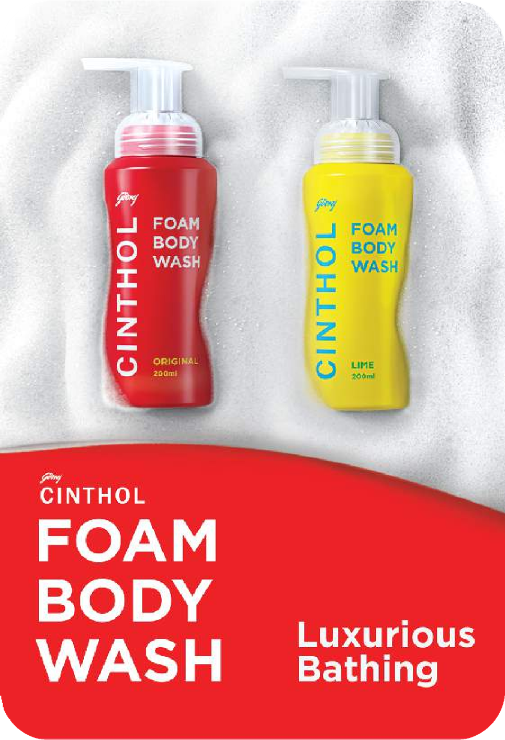
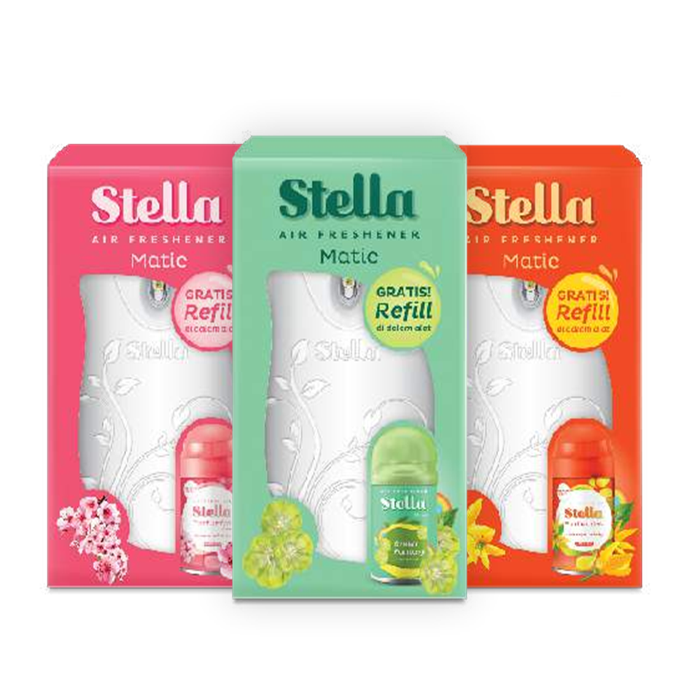
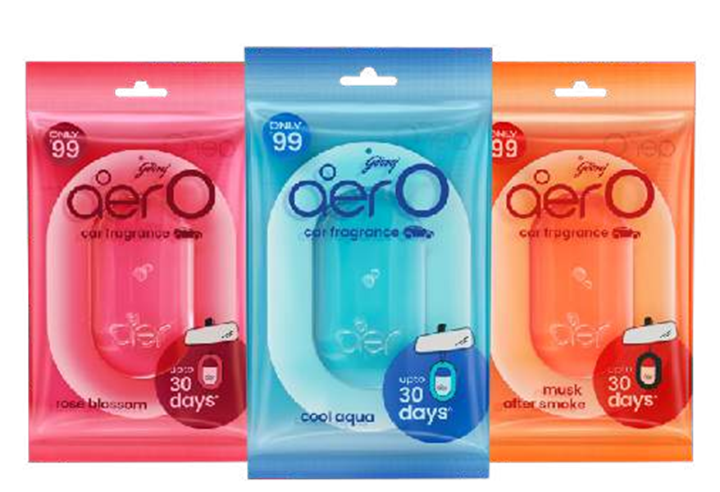
Industry Overview
GCPL operates in the FMCG(Fast-Moving Consumer Goods)-Personal and Home Care Segment.
🔹 Industry Type
Fast-Moving Consumer Goods (FMCG)
Focus: Personal Care (soaps, hair care, grooming) & Home Care (insecticides, air fresheners)
🔹 Market Characteristics
Highly competitive & brand-driven
Volume-led growth; high consumer repeat rate
Low switching costs; pricing & innovation are key
🔹 Demand Drivers
Rising disposable incomes & middle-class expansion
Greater focus on personal hygiene & grooming
Urbanization, lifestyle shifts, digital adoption
Growing rural consumption

Slide 18
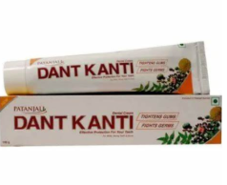
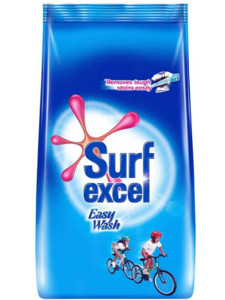
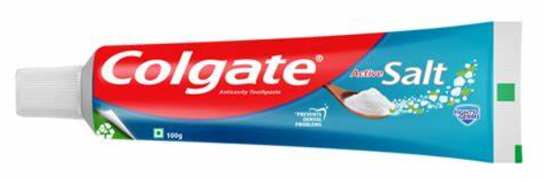

Industry Overview
🔹 Regulatory Environment
Governed by FSSAI, BIS, Drug Controller, etc.
Increasing focus on environmental compliance
🔹 Key Trends
Surge in natural/herbal product demand
Eco-friendly & sustainable product innovation
D2C (Direct-to-Consumer) and e-commerce growth
Health-conscious consumer behavior post-COVID
🔹 Industry Challenges
Raw material price fluctuations (oils, packaging)
Rural inflation affecting demand
Intense competition from domestic & global players
Key competitors include within the industry include:HUL,Dabur India Ltd,Marico Ltd,Emami Ltd,Patanjali Ayurved,Colgate-Palmolive India.

Slide 19
Industry Overview
The Fast-Moving Consumer Goods (FMCG) sector in India is projected to achieve a revenue growth of 7-9% in fiscal year 2025, up from an estimated 5-7% growth in the previous fiscal year. This growth is primarily driven by a revival in rural demand and steady urban consumption and fast digital adoption.
Segment-wise Growth Projections(FY 2025)
Food & Beverages (F&B): Expected to grow by 8-9%, benefiting from improved rural demand.​
Personal Care (PC): Anticipated to see a growth of 6-7%, supported by urban demand and premiumization trends.
Home Care (HC): Projected to grow by 8-9%, driven by continued premiumization and steady urban consumption.
Possible reasons:
Rural Market Revival: An expected better monsoon season and increased agricultural production are likely to boost rural incomes, leading to higher spending on FMCG products.
Urban Consumption Stability: Rising disposable incomes and a focus on premium offerings are sustaining urban demand, especially in the personal and home care segments.​
Government Initiatives: Programs like PMAY-G (Pradhan Mantri Awaas Yojana-Grameen) are enhancing rural infrastructure, contributing to increased consumer spending capacity.
Premiumization: There's a notable shift towards premium products, particularly in urban markets, as consumers seek higher-quality personal and home care items.​
Digital Transformation: The FMCG sector is rapidly adopting digital channels, with online sales valued at approximately ₹1.7 trillion, reflecting evolving consumer purchasing behaviors.

Slide 20
Industry Relative Position
​Godrej Consumer Products Limited (GCPL) holds a prominent position in India's FMCG sector, particularly within the Home and Personal Care segments.
Market Leadership:
Household Insecticides: GCPL is the market leader in India, with its Goodknight brand being a household name.
Soaps: The company ranks second in the Indian market, offering popular brands like Cinthol and Godrej No.1.
Air Fresheners: GCPL holds the number one position in India's air freshener market with its Aer brand.
Financial Performance:
In the quarter ending September 2024, GCPL reported a 14% increase in consolidated net profit, reaching ₹4.91 billion, surpassing analyst expectations.
The Home Care segment grew by 12% year-over-year, driven by double-digit volume growth in air fresheners and fabric care products.
The Personal Care segment experienced a 3% year-over-year growth, with personal wash products maintaining stable volume growth and gaining market share.

Slide 21
Industry Relative Position
Sustainability Recognition:
GCPL has been recognized on the Dow Jones Sustainability Index (DJSI) 2024, ranking among the top three global FMCG companies for sustainability, reflecting its commitment to environmental and social governance.
Strategic Initiatives:
The company is focusing on gradual price adjustments in response to rising raw material costs, particularly palm oil, to protect profit margins without significantly impacting sales.
GCPL continues to innovate and expand its product portfolio, emphasizing both organic growth and strategic acquisitions to strengthen its market position.

Slide 22
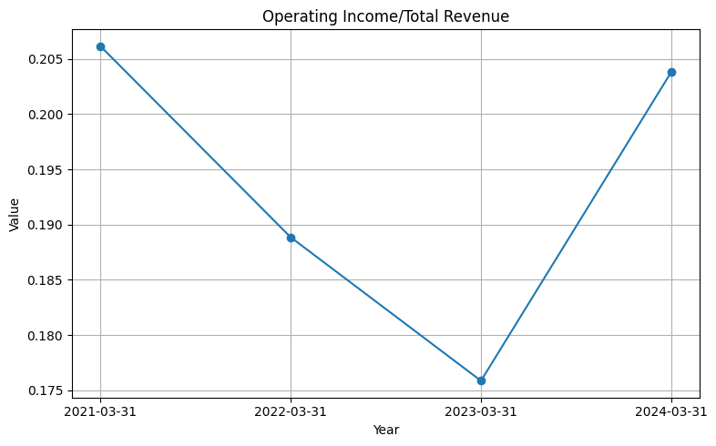
COMMON SIZING
OPERATING INCOME/TOTAL REVENUE:
The common-size analysis of Godrej Consumer
Products’ operating income as a percentage of total
revenue from FY21 to FY24 shows a fluctuating trend
in operational efficiency. The ratio peaked at around
20.6% in FY21, indicating strong cost management,
but declined over the next two years to a low of 17.6%
in FY23, possibly due to rising input costs or
operational challenges. However, the company
rebounded in FY24 with the ratio climbing back to
approximately 20.4%, suggesting improved cost
controls or a favorable shift in product mix.
This recovery highlights the company’s ability to adapt
and regain profitability.

Slide 23
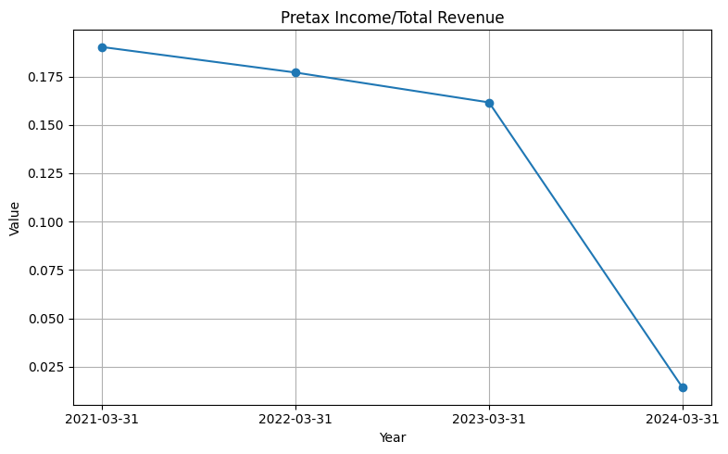
2) PRETAX INCOME/TOTAL REVENUE:
Pretax Income to Total Revenue for Godrej
Consumer Products from FY21 to FY24 reveals a
significant downward trend in overall profitability.
The ratio declined steadily from around 18.8% in
FY21 to 16.2% in FY23, followed by a sharp drop to
just 1.4% in FY24. This drastic fall in FY24
suggests substantial non-operating expenses,
one-time losses, or a significant increase in interest
or other costs that reduced pretax earnings
despite stable operating income. The divergence from the
operating income trend indicates external financial pressures or unusual items affecting profitability at the pretax level.

Slide 24
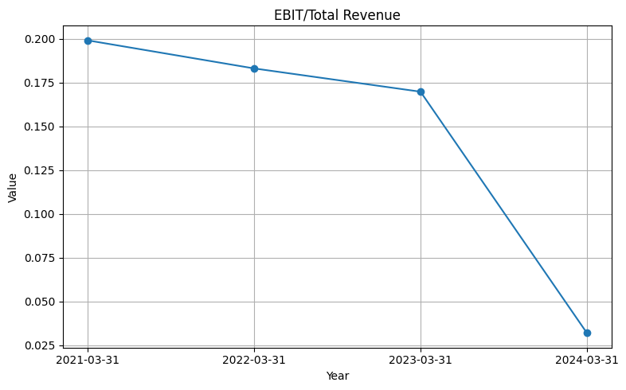
a
3)EBIT/TOTAL REVENUE:
EBIT (Earnings Before Interest and Taxes) to Total
Revenue for Godrej Consumer Products from FY21
to FY24 indicates a continuous decline in core
profitability. The ratio dropped from about 20% in
FY21 to 17% in FY23, followed by a steep fall to just
3% in FY24. This downward trend reflects mounting
operational and possibly extraordinary expenses that
have significantly eroded earnings. The sharp drop in
FY24, despite a recovery in operating income, may
suggest the presence of substantial one-off charges
or increased depreciation/amortization impacting
EBIT. It highlights growing pressure on the
company’s underlying earnings performance.

Slide 25
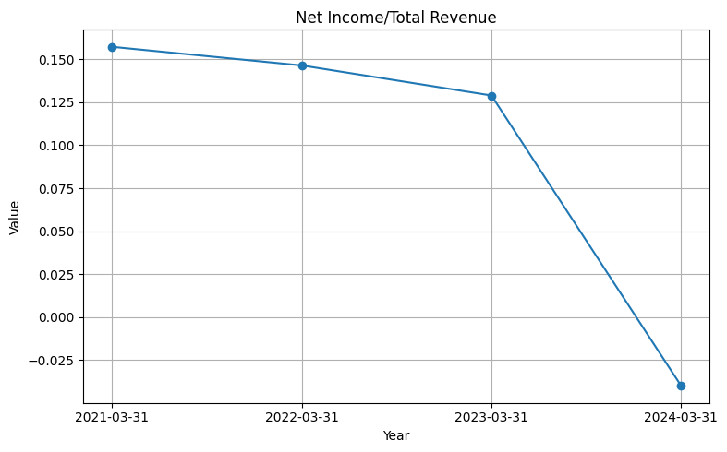
A
4) NET INCOME/TOTAL REVENUE:
Net Income to Total Revenue for Godrej Consumer
Products from FY21 to FY24 reveals a sharp and
concerning decline in overall profitability. The ratio
fell steadily from about 15.8% in FY21 to 12.9% in
FY23, followed by a dramatic plunge into negative
territory at around -3.7% in FY24. This negative net
income margin indicates that the company recorded
a net loss despite positive operating income,
pointing to significant non-operating expenses, exceptional losses, or adverse tax impacts in FY24. The trend highlights a
deterioration in bottom-line performance and raises red flags about financial health in the latest year.

Slide 26
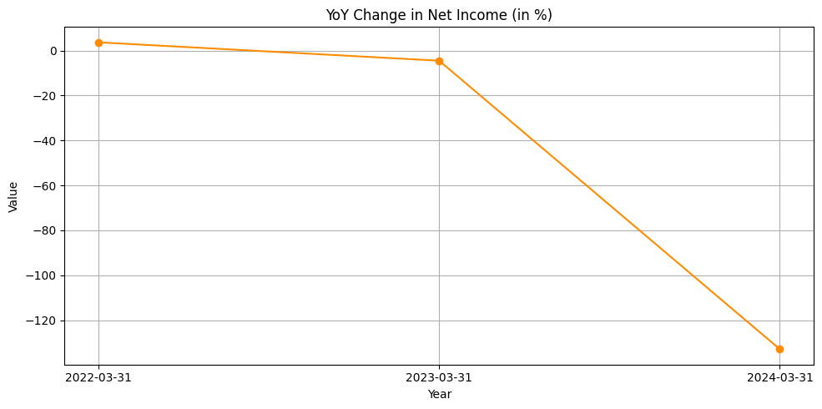
HORIZONTAL ANALYSIS
YOY CHANGE IN NET INCOME
YoY Change in Net Income (%) for Godrej
Consumer Products presents a sharp deterioration
in profitability over the three-year span. In FY22, the
company saw a modest positive growth of net
income, indicating a stable performance. However,
in FY23, net income declined slightly, as shown by
a small negative percentage. The situation worsened
drastically in FY24, with a steep decline of over 120%, indicating that the company swung from a profit to a net loss. This
severe drop suggests a major adverse event or accumulation of financial pressures, such as extraordinary losses, higher
financing costs, or poor investment returns, severely affecting the company’s bottom line

Slide 27
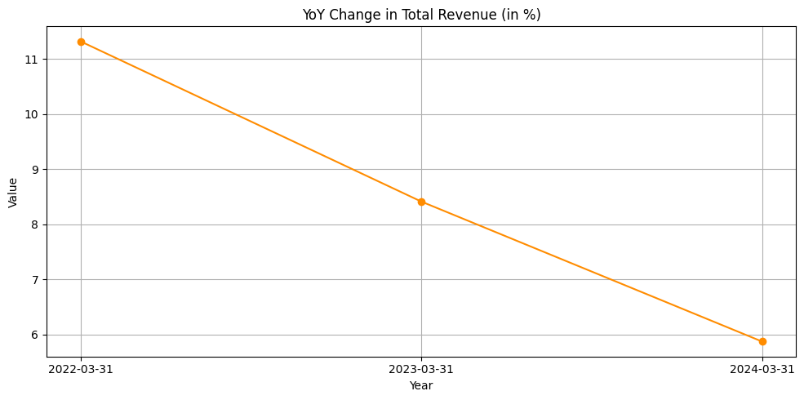
a
2) YOY CHANGE IN TOTAL REVENUE
YoY Change in Total Revenue (%) for Godrej
Consumer Products indicates a declining growth
trend over the past three fiscal years. In FY22,
revenue grew by a strong 11.3%, reflecting healthy
sales momentum. However, this growth slowed to
8.4% in FY23 and further dropped to 5.9% in FY24.
While the company is still growing, the pace of
growth is decelerating, possibly due to market
saturation, competitive pressures, or reduced consumer demand. This slowdown in revenue growth, combined with the
sharp drop in net income (as seen in the previous graph), suggests that cost pressures or inefficiencies are escalating
faster than revenue, squeezing margins and profitability.

Slide 28
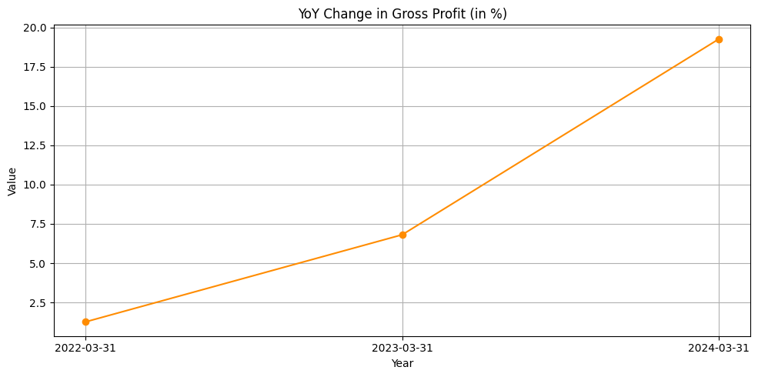
A
3) YOY CHANGE IN GROSS PROFIT:
YoY Change in Gross Profit (%) for Godrej
Consumer Products shows a positive and
accelerating trend in gross profitability. Gross
profit growth increased from a modest 1.3% in
FY22 to 6.8% in FY23, and then surged to an
impressive 19.2% in FY24. This trend suggests
that the company has been improving its cost
of goods sold efficiency, possibly through
better sourcing, pricing strategies, or a favorable product mix. However, this strong performance at the gross level contrasts
sharply with declining net income, implying that costs beyond production—such as operating expenses, interest, or
exceptional items—are severely impacting overall profitability.

Slide 29
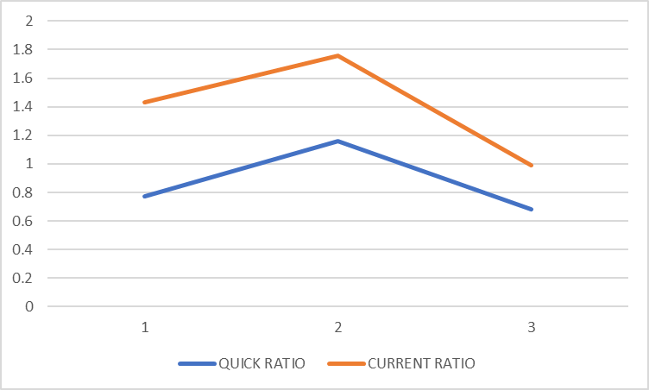
PROSPECTIVE ANALYSIS ON RATIOS
LIQUIDITY RATIOS:
QUICK AND CURRENT RATIO:
The graph shows that both the Quick Ratio and
Current Ratio improved initially (Point 1 to 2), indicating
stronger liquidity, but then declined at Point 3, suggesting a
weakening short-term financial position. The consistently
higher Current Ratio implies reliance on inventory or other
current assets not included in the Quick Ratio.

Slide 30
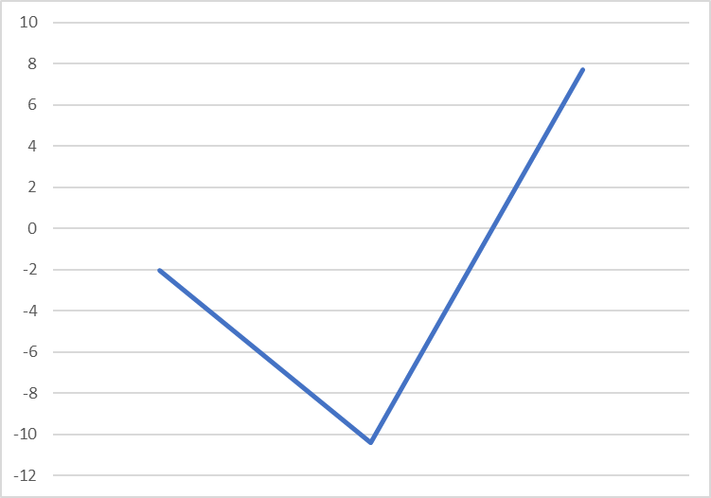
A
SOLVENCY RATIOS:
DEBT TO EQUITY RATIO:
The graph indicates that the debt-to-equity ratio dropped
sharply into negative values, suggesting that the company
may have had negative equity—possibly due to
accumulated losses or high debt levels. However, the
strong upward shift into positive territory reflects a
significant improvement in the capital structure, likely due
to increased equity, reduced debt, or both, pointing to
improved financial health.

Slide 31
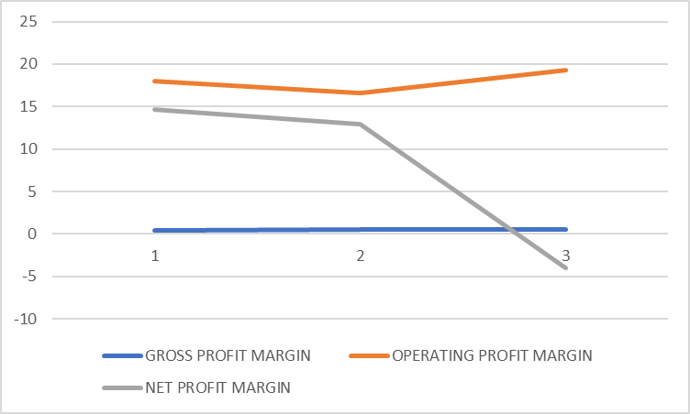
A
PROFITABILTY RATIOS :
GROSS PROFIT MARGIN,OPERATING PROFIT MARGIN, NET PROFIT MARGIN:
The graph indicates that the gross profit margin remains
relatively constant, suggesting stable production or sales
efficiency. The operating profit margin shows a slight dip in
the second period but recovers in the third, implying
controlled operating costs. However, the net profit margin
declines steadily and turns negative in the third period,
signaling that despite operational stability, significant
non-operating costs—such as interest, taxes, or one-time
losses—are severely reducing overall profitability. This trend raises
concerns about the company's financial sustainability beyond its core operations.

Slide 32
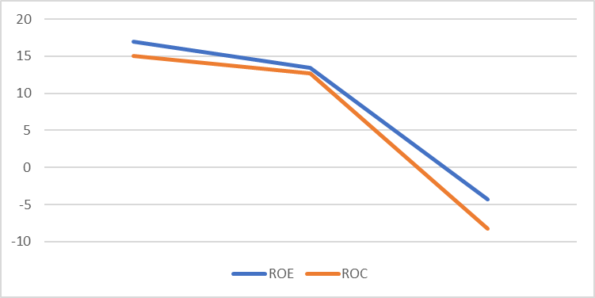
a
2) ROE AND RETURN ON CAPITAL:
The graph indicates a consistent decline in both
Return on Equity (ROE) and Return on Capital
(ROC) over the three periods. Initially, both returns
are healthy, with ROE slightly higher than ROC,
suggesting efficient use of equity and capital.
However, by the third period, both metrics fall
sharply—ROE turns slightly negative, and ROC
drops further below zero. This suggests a significant decline in profitability and efficiency, possibly due to falling net income,
poor asset utilization, or increased financing costs. The negative ROC is particularly concerning, as it indicates the company is destroying value rather than .creating it.

Slide 33
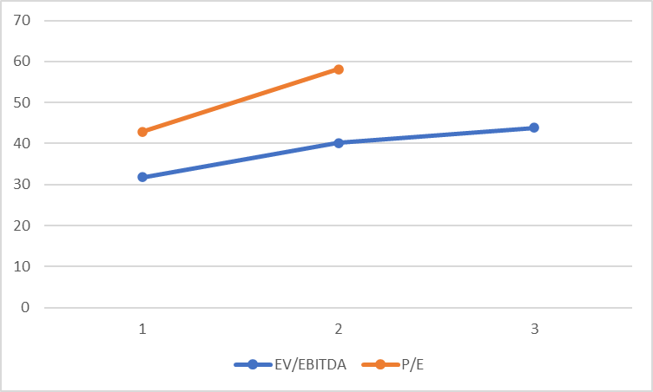
A
VALUATION RATIOS:
P/E RATIO AND EV/EBITDA RATIO :
The graph indicates that both EV/EBITDA and P/E ratios
are increasing over the observed periods, suggesting
growing investor confidence and a higher market valuation
relative to the company's earnings and cash flow. The
EV/EBITDA ratio rises steadily, reflecting an increasing
valuation based on operational performance. The P/E ratio
shows a sharper increase between the first and second
periods, implying stronger market expectations for future earnings. This upward trend could signal positive growth prospects,
but if not backed by actual performance improvements, it may also point to overvaluation.

Slide 34
FCFF & FCFE PROJECTION
FCFE (Free Cash Flow to Equity):
FCFE=Net Income+Depreciation and Amortization−Capital Expenditures−Change in Working Capital+Net Borrowing
FCFE represents the cash flow available to equity shareholders after all expenses, reinvestments, and debt repayments have been accounted for.
FCFF (Free Cash Flow to Firm):
FCFF=EBIT(1−Tax Rate)+Depreciation and Amortization−Capital Expenditures−Change in Working Capital
FCFF is the cash flow available to all capital providers (equity and debt holders) before interest payments and distributions to shareholders.

Slide 35
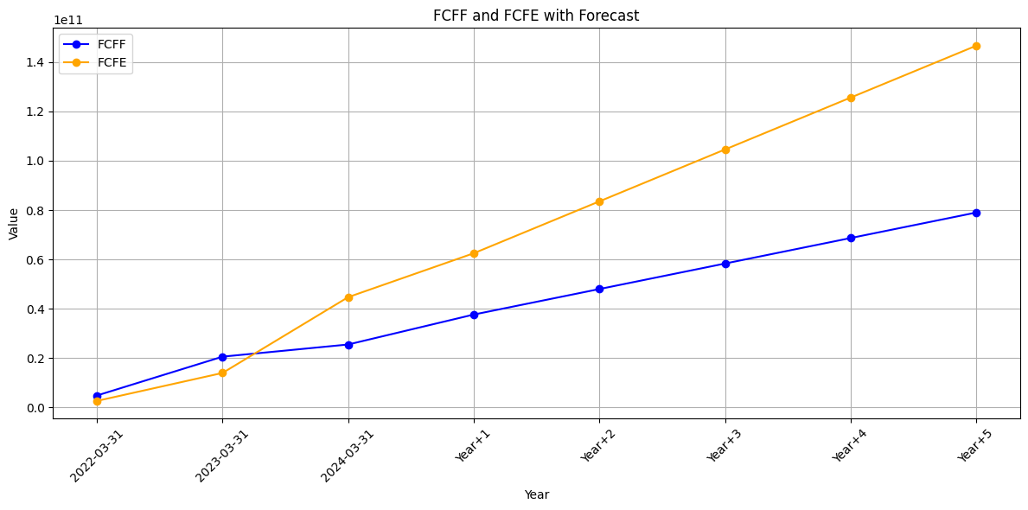
FCFF & FCFE PROJECTION

Slide 36
CALCULATING BETA USING REGRESSION
Regression seeks to discover the degree of the relationship (Beta) between dependent variable and independent variables.
Regression performed between GCPL Monthly Equity Returns (Ri) and NIFTY50 Monthly Returns (Rm).
The measure of the systematic risk in the market or 𝛃 is calculated using a time-series regression analysis.
Calculated 𝛃 for GCPL = 0.5983

Slide 37
CALCULATING COST OF EQUITY
The CAPM model is used to determine the cost of equity capital for the firm.
The value of beta was calculated using regression analysis as well as top down approach.
The risk free rate was taken as the ytm of the government bonds while Nifty returns were taken for Rm.
COST OF EQUITY FORMULA: K_{E} = R_{F} + 𝛃(E(R_{M}) - R_{F})

Slide 38
CALCULATING COST OF DEBT
The cost of debt is the effective interest rate or the total amount of interest that a company or individual owes on any liabilities, such as bonds and loans.
The primary company (GCPL), based on its Interest Coverage Ratio has a Credit Rating of B1/B+ which corresponds to a spread Value of 2.61%.
RISK FREE RATE + SPREAD = COST OF DEBT
INTEREST COVERAGE RATIO = 1.79844
SPREAD = 2.61%
COST OF DEBT = 6.384%

Slide 39
MARKET VALUE OF EQUITY
The market value of equity, also known as market capitalization, represents the total value of a company's ownership as determined by the stock market. It is the aggregate value of all outstanding shares of a company's stock, reflecting the price investors are willing to pay for the company at a given point in time.
Market Value of Equity=Current Share Price×Total Number of Outstanding Shares
This value represents how much the company is worth in the eyes of investors and traders in the stock market. It is a dynamic measure that changes as the company’s stock price fluctuates due to various factors such as company performance, economic conditions, and investor sentiment.
The market value of equity serves as an indicator of a company's size and is often used to classify companies as small-cap, mid-cap, or large-cap. It is also an important metric for evaluating investment opportunities and comparing companies within the same industry.
Closing Stock Price = 1159.25
No of Shares Outstanding = 1022820329
Market Value of Equity=Current Share Price×Total Number of Outstanding Shares
Market Cap on 31 March 2024: 11,85,70,44,66,393.25

Slide 40
MARKET VALUE OF DEBT
The formula for the market value of a bond is:
Market Value of Debt=∑ C/(1+r)^t+F/(1+r)^n
C is the annual coupon payment (interest). r is the current market interest rate or yield. t is the time period (year) for each coupon. F is the face value or principal of the bond.
n is the total number of periods (years) until maturity.
Annual Coupon Payment=Book Value of Debt×Annual Coupon Rate
Present Value of Coupon Payments:
Coupon Payments PV=∑ Annual Coupon Payment/(1+Cost of Debt)^t
Present Value of Principal:
Principal PV= Book Value of Debt/ (1+Cost of Debt)^T
Market Value of Debt=Coupon Payments PV+Principal PV
Book Value of Debt on 31 March 2024:
Cost of Debt = 6.384%
Market Value of Debt: 32,22,21,00,000

Slide 41
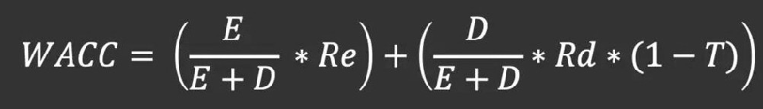
CALCULATING WACC
Weighted Average Cost of Capital (WACC) represents a company's average after-tax cost of capital from all sources, including common stock, preferred stock, bonds, and other forms of debt. As such, WACC is the average rate that a company expects to pay to finance its business.
D = 32,22,21,00,000
E = 11,85,70,44,66,393.25
E/V = 0.99135
D/V = 0.00864
WACC = 0.14598

Slide 42
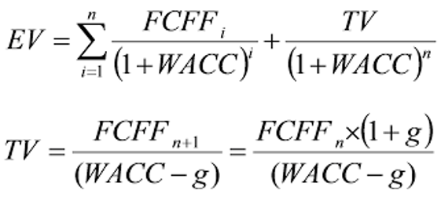
VALUING FIRM USING DCF
Having projected different income statements and balance sheet figures using rolling means and OLS estimates, we project FCFE and FCFF cash flow streams for the next five years.
We calculate terminal value using discount rates and growth rate that we have estimated.
These are used as inputs in DCF valuation method and an NPV of the firm is computed.
DCF METHOD | TERMINAL VALUE | g | VALUATION
FCFF | 118365.024Cr | 5.91% | 88825.68Cr
FCFE | 169821.67Cr | 7.74% | 116979.09Cr

Slide 43
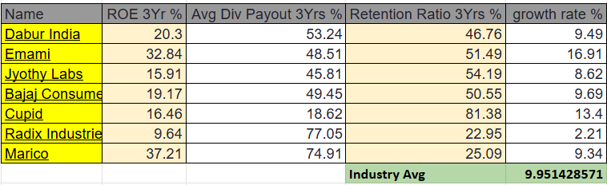
TERMINAL GROWTH RATE
Growth Rate Using Reinvestment Rate and ROE and ROA for GCPL :
GROWTH RATE FOR FCFF : 5.91% ( ROA * Retention Ratio)
GROWTH RATE FOR FCFE = 7.74% (ROE * Retention Ratio)
Growth Rate Using Relative Valuation Method : The 3-year average ROE and Dividend payout ratio was taken to get a growth rate. These growth rate values were averaged to get an industry average growth rate, which is used as a relative growth rate for our firm Godrej Consumer Products Ltd
Thus, we get g= 9.95% from relative approach

Slide 44
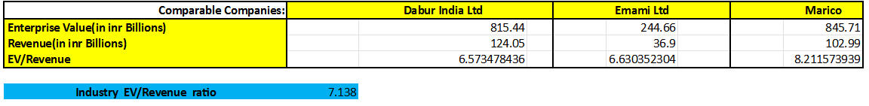
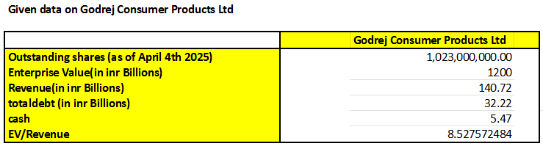
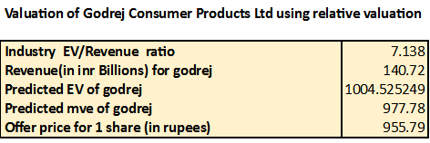
Relative valuation of company
At a current price of 1157 rupees compared to the calculated fair value of 955.79 rupees, Godrej Consumer Products is overvalued by approximately 21%.

Slide 45
References
Bloomberg https://docs.google.com/spreadsheets/d/1KCsms5D8CceRTbYki4ygCs5vlzVhCAvu/edit?usp=sharing&ouid=101057529683988520379&rtpof=true&sd=true

Slide 46
Thank You

